Slide 1
IS 380 Physical Security
Chapter 6

Slide 2
Types of physical threats
Natural environmental threats
Supply system threats
Manmade threats
Politically motivated threats

Slide 3
Life Safety
Protecting life is the first priority
Notes:
P403

Slide 4
. . Like an Onion
Layered Defense model
If one layer fails, another layer protects.
Notes:
P404

Slide 5
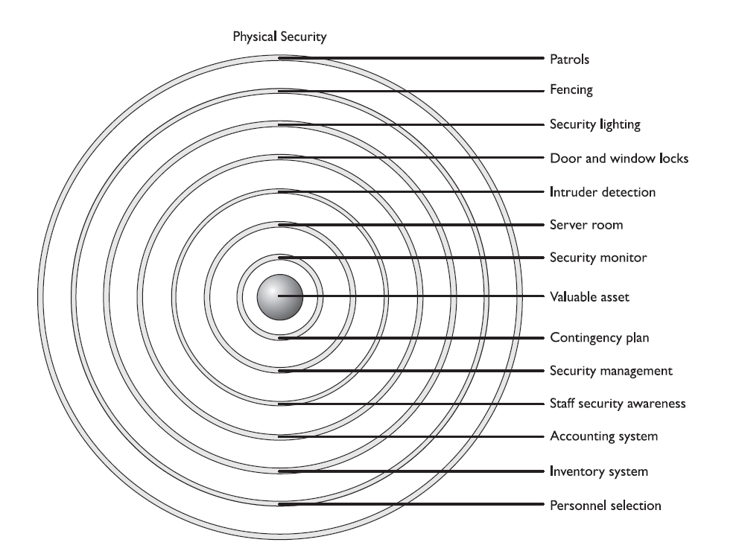
Notes:
P446

Slide 6
CPTED
Crime Prevention Through Environmental Design – facility design, lighting and landscaping.
Natural Access Control
Natural Surveillance
Natural territorial reinforcement
Target Hardening – locks, etc

Slide 7
Physical Security
Deter
Delay
Detect
Assessment
Response

Slide 8
Facility – location/terrain, proximity to fire/police, etc.
Construction
Entry Points
Man trap
Fail safe
Fail secure
Notes:
P422

Slide 9
Water is not a datacenter’s friend
Internal partitions – do they go past the drop ceiling?
Windows – Standard, Tempered, Acrylic, Wired, Laminated, film (solar/Security)
Computer room location
Access door (not doors).
Emergency off switch
Positive air pressure
Fire suppression
Notes:
P423

Slide 10
HVAC
Dedicated HVAC system
Temp 70°-74°F
40%-60% humidity
Closed loop – air reused
Positive pressurization – smoke goes out
Store backups in a safe
Encrypt backups

Slide 11
Laptop safety
Inventory laptop, serial number. Engraving
Don’t let the laptop out of sight when traveling
Most laptop locks are a joke.
Back up your critical data.
Encrypt the hard drive (or at least critical data) – BitLocker – TruCrypt
Lojack for laptops.

Slide 12
Clean Power
UPS
Online - faster
Standby – cheaper
Voltage regulator/line conditioner
Spike/Surge, Fault/Blackout, Sag/brownout
In-rush current
Electromagnetic interference – other wires
Radio frequency interference – fluorescents
Generator
Notes:
P432

Slide 13
Fire: Prevent Detect & Suppress
Prevention – training, equipment, construction. BOXES
Detection – pull boxes, detectors, autodial
Suppression
Plenum area & plenum materials

Slide 14
Fire Suppression
A – wood & paper - Water & foam
B – petroleum, natural gas – Gas, foam, powder
C – electrical – Gas, dry powders
D – metal – Powder/chemical specifically for Class D (NaCl, graphite, powdered copper)
K – cooking oil or fat (sub-type of class B)

Slide 15
CO2, Halon, FM-200
Halon – CFC, 10% concentration danger
FM-200 - in

Slide 16
Wet pipe/dry pipe
Wet pipe – always has water. Freezing problem.
Dry pipe – pipes dry until there is a fire
Preaction – dry pipe and thermal-fusible sprinklers.
deluge

Slide 17
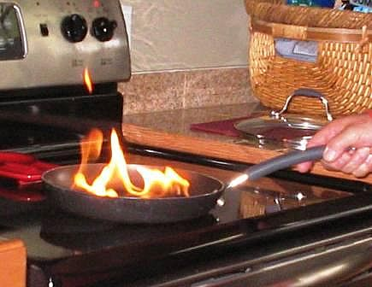

Slide 18
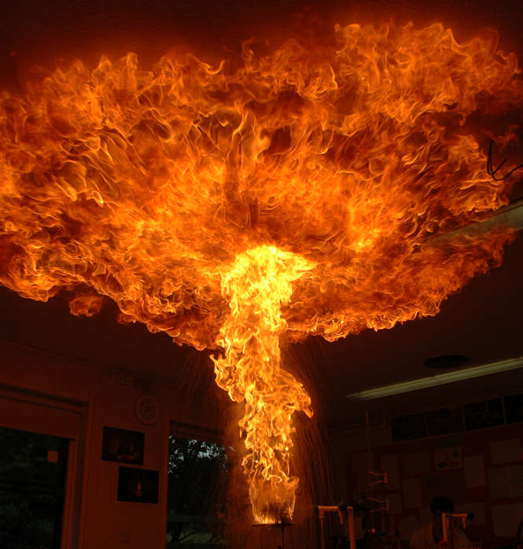

Slide 19
Locks
Keep honest people honest.
UL rating is on delay time.
Test | Door Locks/Cylinders | Security Container Key Locks | Two-Key Locks
Picking | 10 | 30 | 45
Impressioning | 10 | 30 | 45
Forcing | 05 | 30 | 05
Drilling | 05 | 30 | n/a
Sawing | 05 | 30 | n/a
Prying | 05 | 30 | n/a
Pulling | 05 | 30 | n/a
Punching | 05 | 30 | n/a
Notes:
REF: http://www.lockwiki.com/index.php/UL_437

Slide 20
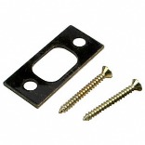
Locks (cont)
Lockpicking
Keybumping
Kicking in the door
Reinforce deadbolt strikeplate;the ‘weakest link’
Use screws at least 3” long (studs behind door frame).
About $3-$5 on amazon.com
Notes:
REF: amazon.com

Slide 21
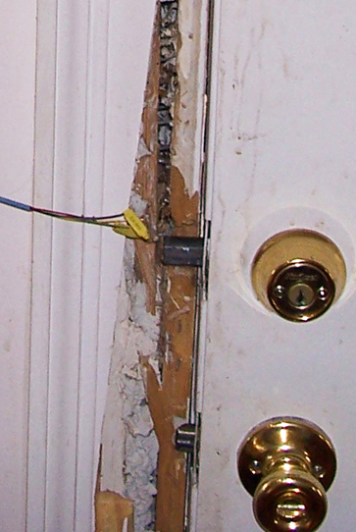

Slide 22
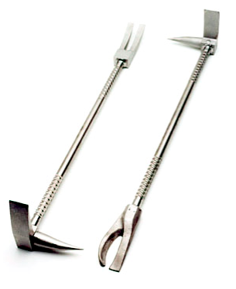
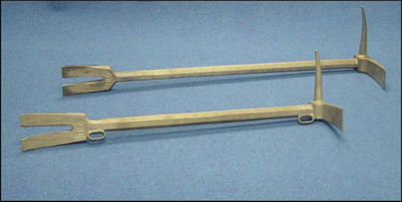
Notes:
Halligan bar

Slide 23
Security in general
32.00% Through unlocked window or door
26.64% Forced entry by impacts
24.02% Prying or jimmying
6.79% Use of pass key or picking the lock
5.10% Entry attempted, but failed
5.45% Other or unknown

Slide 24
More on locks
Warded lock – some padlocks
Tumbler lock
Pin – most common
Wafer – no keybumping
Lever tumbler
Combination locks
Cipher locks

Slide 25
Access cards
Magnetic swipe cards
Proximity cards – not all cards are created equal.
PIN?
Piggybacking

Slide 26
How to respond to a physical attack?
Deterrence – Fences, Gates, Guards
Delay – Barriers, man traps, locks
Detection – Motion detectors, cameras, smoke alarms
Response procedures – Fire evacuation plan, emergency phone numbers

Slide 27
Site selection questions
Crime in area
Emergency services available
Markings and signs on building
Accessibility
Some of these may run counter to non-security goals

Slide 28
External protection mechanisms
Fencing (3’-4’, 6’-7’, 8’) different mesh
Gates
Bollards
Lighting – (critical areas 8’ high two foot-candles)
Continuous, controlled, standby & responsive.
Surveillance devices – DVR, motion triggered recording/alerting
Guards and dogs
CPTED

Slide 29
Intrusion detection systems
Beams of light
Sound and vibrations
Motion
Microwave, ultrasonic, or electrostatic fields
Electrical circuit (electromechanical)
PIR – passive infrared
Acoustical –prone to false alarm (some glass breaks are good)

Slide 30
Guards
Flexible, good response, deterrent
Costly, usual personnel issues.

Slide 31
Auditing physical access
Date and time of access attempt
Where access was attempted (Entry point)
User ID when access was attempted
Failed attempts, especially off-hours

Slide 32
Tests and drills
Test evacuation plan
Test other plans so people know what to do in a real emergency.

